Slide 1
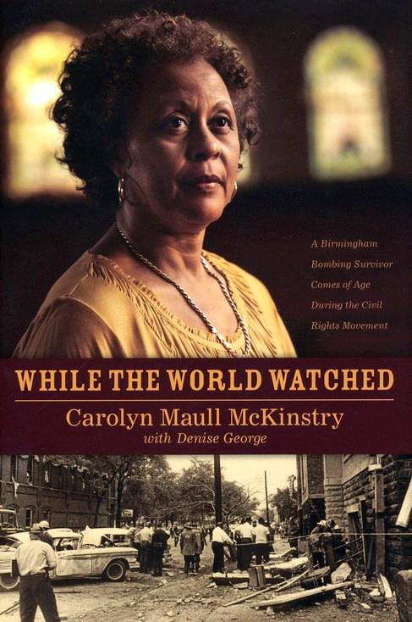
ELACC7RI3: Analyze the interactions between individuals, events, and ideas in a text (e.g., how ideas influence individuals or events, or how individuals influence ideas or events).
ELACC7SL2: Analyze the main ideas and supporting details presented in diverse media and formats (e.g., visually, quantitatively, orally) and explain how the ideas clarify a topic, text, or issue under study.
ELACC7SL1: Engage effectively in a range of collaborative discussions (one-on-one, in groups, and teacher-led) with diverse partners on grade 7 topics, texts, and issues, building on others’ ideas and expressing their own clearly.
Carolyn Maull McKinstry
Video Presentation

Slide 2
TASKS
1. View the video and be prepared to discuss the questions that follow.
2. Record your responses on the activity sheet provided by your teacher.

Slide 3
Carolyn McKinstry Presentation
*Clicking on the book hyperlinks to Carolyn McKinstry on-line presentation.

Slide 4
Discussion Questions
How does Mrs. McKinstry describe life in Birmingham, Alabama during the 1950’s and 1960’s? List two or three examples of discrimination that African-Americans faced in Alabama during this time.
Identify the significance of the 16th Street Baptist Church to the African-American community in Birmingham, Alabama before and during the Civil Rights Movement as described by Mrs. McKinstry.
How did Mrs. McKinstry’s parents attempt to protect her from segregation and violence in Birmingham during her childhood?

Slide 5
Discussion Questions
4. Mrs. McKinstry discusses Dr. King’s speech at the 16th Street Baptist Church, what effect did his speech have on her? Why was non-violence important? What did Dr. King want to change about Birmingham?
5. Mrs. McKinstry discusses two specific experiences with segregation – her grandmother in the hospital and her exclusion from the national spelling bee, reflect on her experiences. Have you ever experienced discrimination based on something beyond your control – age, race, religion or gender? Please describe your experience below.
6. Mrs. McKinstry decides to march with other children and students in Birmingham, Alabama in August of 1963. Why does she decide to march? Why was Dr. Martin Luther King Jr. hesitant about the children participating in the march? Identify two reasons why Reverend Shuttlesworth wanted to use the children/students.

