Slide 1
Greetings
from Tabor City Middle School

Slide 2
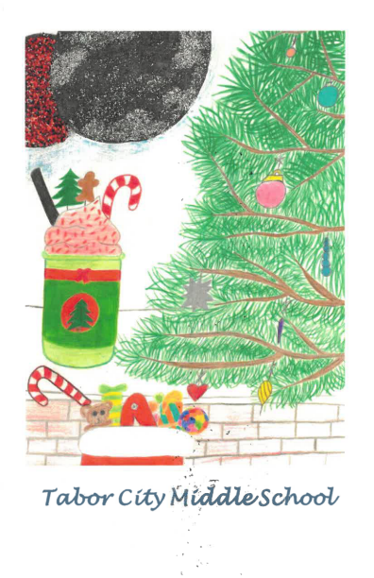

Slide 3
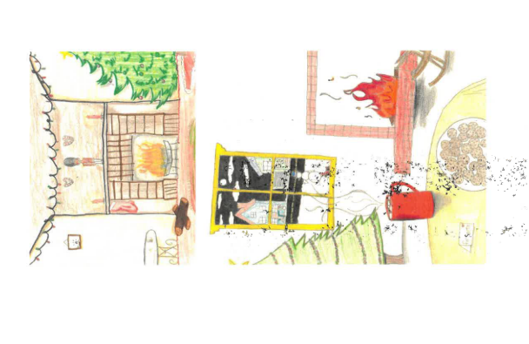

Slide 4
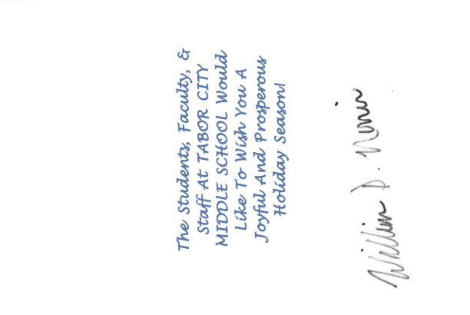

Slide 5
